Slide 1

Interactive web pages
programming
Jimmy farley
Creating interactive web pages with dom

Slide 2
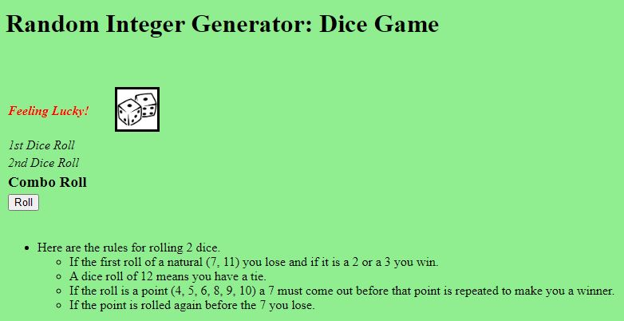
Installing jsdom to debug
https://www.npmjs.com/package/download (create an account, enter your email and verify it)
https://www.npmjs.com/ (Node Package Manager - npm is the package manager for the Node JavaScript platform
Search for jsdom
Or https://github.com/jsdom/jsdom
Install jsdom: npm i jsdom
Install all on root drive(c:) and test JS files from root (index.js)

Slide 3
Objectives
What is an event?
Adding event listeners
Event Bubbling

Slide 4
What is an event ?
Something the browser does, or something the user does
Events
change
click
dblclick
mouseover
mouseout
keydown
load

Slide 5
Event Listeners
document.getElementById(“btnCheck”).addEventListener(“click”, someFunction)
It is what fires when the user does one of the before mentioned events (ex. Clicks a button)
addEventListener() – method attaches to an event handler to a specific element.

Slide 6
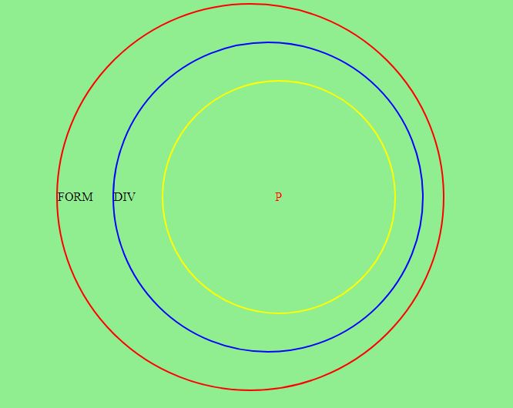
Event bubbling
The order in which event handlers(routine) are called when one element is nested inside another element, and both elements have a listener(object) for the same event.

Slide 7

Questions and Answers
Any Questions ?

Slide 8

Have fun coding ! The end

